Slide 1
Prevention of ddOs attack in a private network
Agenda -

Slide 2
Presented by-
NAME – Mousam Maji
Roll No – 10800120066
4th year Department of computer science and engineering (2020-24)
NAME – Tabbassum parween
Roll No – 10800120089
4th year Department of computer science and engineering (2020-24)
NAME – Adarsh bharti
Roll No – 10800120112
4th year Department of computer science and engineering (2020-24)
NAME – riya gorai
Roll No – 10800120117
4th year Department of computer science and engineering (2020-24)

Slide 3
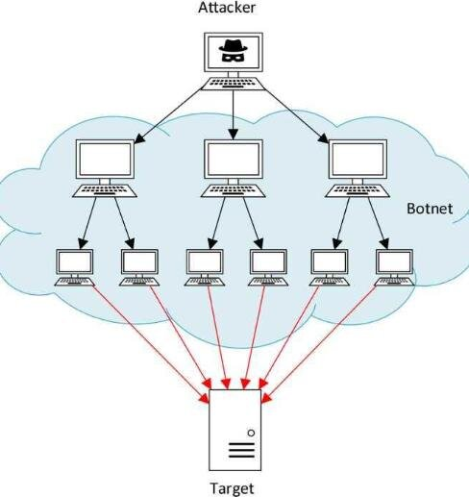
Ddos (Distributed Denial-of-Service )
A Distributed Denial of Service (DDoS) attack is a type of cyber attack in which multiple compromised computers, often referred to as a botnet, are used to overwhelm a target system, server, or network with a flood of internet traffic. The goal of a DDoS attack is to disrupt the normal functioning of the targeted system, making it slow or completely unavailable to legitimate users.
Mechanism:
Botnet: It is a network of infected computers or devices controlled by the attacker.
Traffic Overload: The ‘Botnet’ can be in the form of HTTP requests, TCP/IP packets, or other types of data.
Resource Exhaustion: The traffic overload the target’s resources, such as bandwidth, CPU, or memory, causing it to slow down or crash.

Slide 4
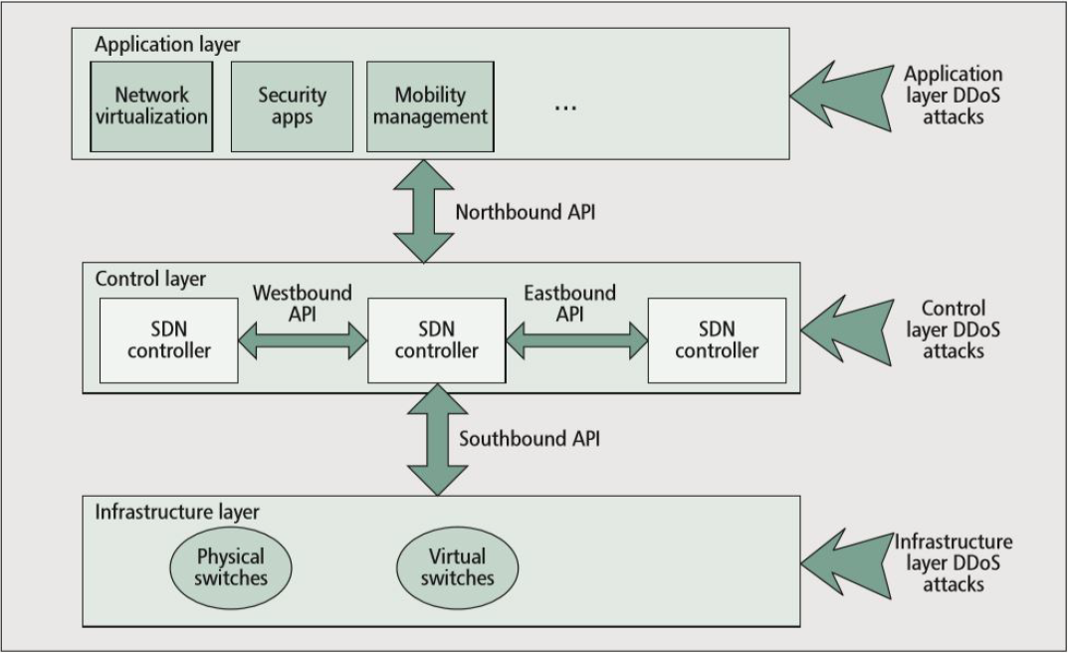
Ddos (Distributed Denial-of-Service ) - Current Detection Methods
Types of attacks:
Application layer DDoS attack - The attacker attempts to overload specific functions of an application to make the application unavailable or unresponsive to legitimate users.
Control layer DDoS attack – It is a method that cybercriminals use to communicate with compromised devices within a target company's network.
Infrastructure layer DDoS attack - An attacker can use either of these methods to generate large volumes of traffic that can inundate the capacity of a network or tie up resources on systems such as servers, firewalls, intrusion prevention system (IPS), or load balancer.
Current ways to detect attacks:
Signature-Based Detection
Anomaly-Based Detection
Rate-Based Detection

Slide 5
Methodology
Speed of IP Sources: This feature gives the total number of TP sources incoming in the network within a particular time interval.
FlowCount of the Traffic: Every network traffic incoming in the network has a particular number of flow counts.
Speed of Flow Entries: This is the total number of flow entries to the switch in the network within a particular time interval.
Ratio of Pair-Flow Entries: This is the total number of flow entries incoming in the switch which are the interactive IPs divided by the total number of flows in the T time period.
Statistical Analysis of traffic Features
1. Speed of IP sources
2. Flowcount
3. Speed of flow entries
4. Ratio of pair-flow entries
Machine learning method
1. Support vector machine-Used For Evaluation
2. Decision tree
SVM: The goal of the SVM algorithm is to create the best line or decision boundary that can segregate n-dimensional space into classes so that we can easily put the new data point in the correct category in the future. This best decision boundary is called a hyperplane.
Decision Tree: In this method there are two nodes, which are the Decision Node and Leaf Node. Decision nodes are used to make any decision and have multiple branches, whereas Leaf nodes are the output of those decisions and do not contain any further branches. It is a graphical representation for getting all the possible solutions to a problem/decision based on given conditions.

Slide 6
Methodology
Data Collection of the statistical features.
Attack traffic
SVM will be using this dataset to train itself and to predict the traffic as normal or DDOS attack traffic.
Normal traffic

Slide 7
Data Collection
Tools Used for Data Collection
Network Monitoring Tools Integrated with SDN: These tools are essential for collecting real-time traffic data across the network.
Process of Data Collection
Packet Count: The number of packets transmitted over the network. Byte Count: The volume of data (in bytes) transmitted. Flow Duration: The time duration for which a particular flow of data persists.
Components Involved
SDN Controller: Manages the network and collects traffic data from network switches. It plays a crucial role in data collection and in implementing mitigation strategies. Network Switches: Devices that direct data on the network and are sources of the collected traffic data. Traffic Flow Data: The actual data collected, including various metrics that describe the traffic patterns and behaviors in the network .

Slide 8


Development tools
VMware Workstation: Used to create a virtual environment.
Ubuntu 20.04 is installed within this virtual environment to provide the operating system necessary for the simulation.
OpenFlow: Acts as a communications protocol for Software-Defined Networking (SDN).
Provides access to the forwarding plane of a network switch or router over the network, which is essential for network configuration and computation in SDN.

Slide 9



Simulation tools
Mininet: Serves as a network emulator.
Creates a network of virtual hosts, switches, controllers, and links. Mininet hosts run standard Linux network software, and its switches support OpenFlow for flexible custom routing and Software-Defined Networking. It's used primarily because it supports the OpenFlow protocol and provides an inexpensive platform for developing, testing, and creating custom topologies in the network.
Ryu Controller: Functions as an SDN controller.
An open-source, Python-based SDN controller designed to increase network agility by making it easy to manage and adapt how traffic is handled. It provides programming capabilities to control the routing operations within the network.
Iperf: Measures network performance.
A network performance tool used to measure bandwidth and datagram loss in a network. It assesses Transport Control Protocol (TCP) and User Datagram Protocol (UDP) network throughput and data streams, facilitating performance measurement by creating client and server functionality for both source and destination nodes

Slide 10
Demonstration of the project
OneDrive Video Link-
https://studentncirl-my.sharepoint.com/:v:/g/personal/x18201687_student_ncirl_ie/EXOe698taxNFlZljcpfPaEEBl8jAlhyWpxEQGeMP9_VmnQ?e=qd1ujN

Slide 11
Evaluated Results Before Attack Mitigation

Slide 12
Evaluated Results Before Attack Mitigation

Slide 13
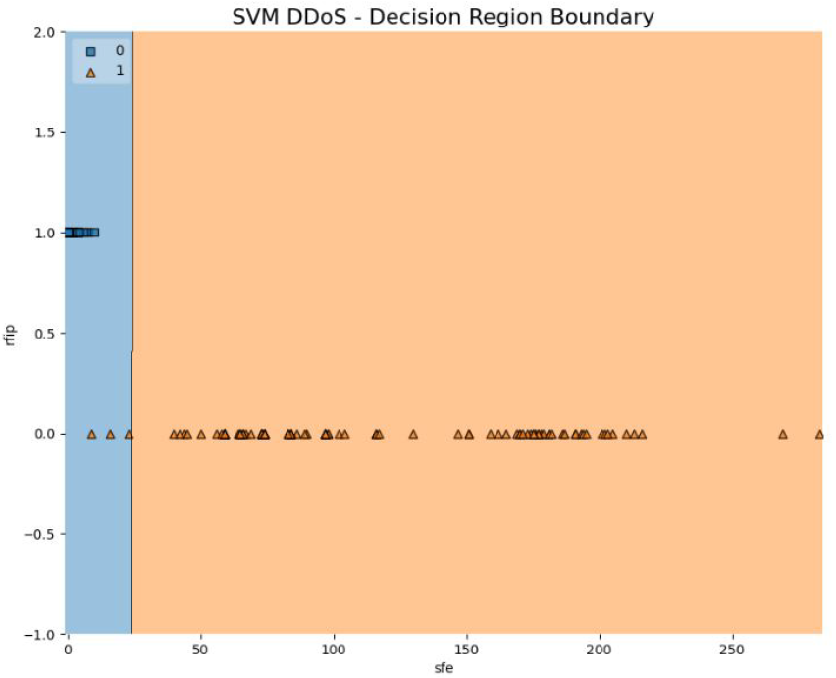
SVM Prediction Graph

Slide 14
Evaluated Results After Attack Mitigation

Slide 15
Evaluated Results After Attack Mitigation

Slide 16
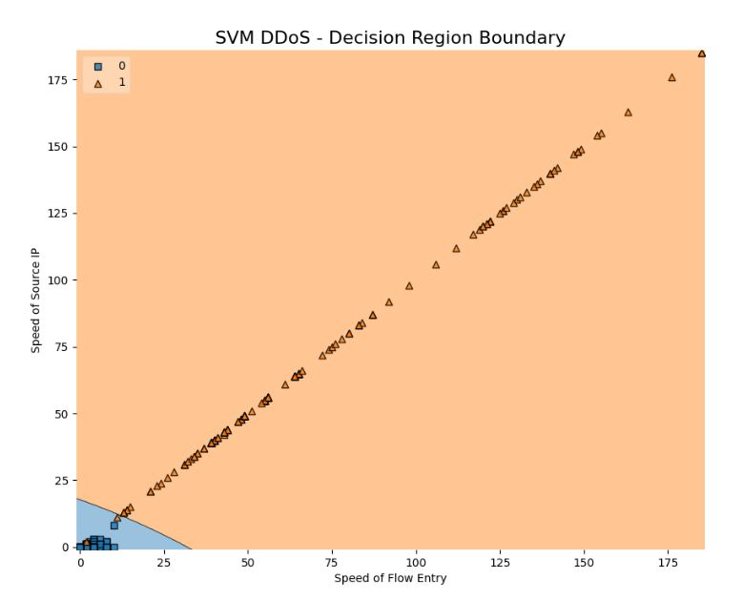
SVM Prediction Graph

Slide 17
Limitation of this method
Faulty dataset trained to the SVM
Trusted IP can be used to attack the network which the SVM would not detect.

Slide 18
Future Work
Multiple controller and switches network topology
More parameters defined and features extracted from the network
Deployment in real time network traffic.

Slide 19
Thank You

